Slide 1
Visions of clouds: Intel® and AWS*
Martin Kronberg – Technical Evangelist
*Other names and brands may be claimed as the property of others.
Notes:
Hello and thank you for coming! My name is Martin Kronberg and today I want to talk to you about computer vision. Specifically I want to discuss how we can combine the strengths of local computer vision with the strength of cloud based computer vision to create a hybrid system and then share a demo of it in action!

Slide 2
Outline
Intro
Intel IoT Overview
AWS Overview
CV at the Edge
CV in the Cloud
Demo!

Slide 3
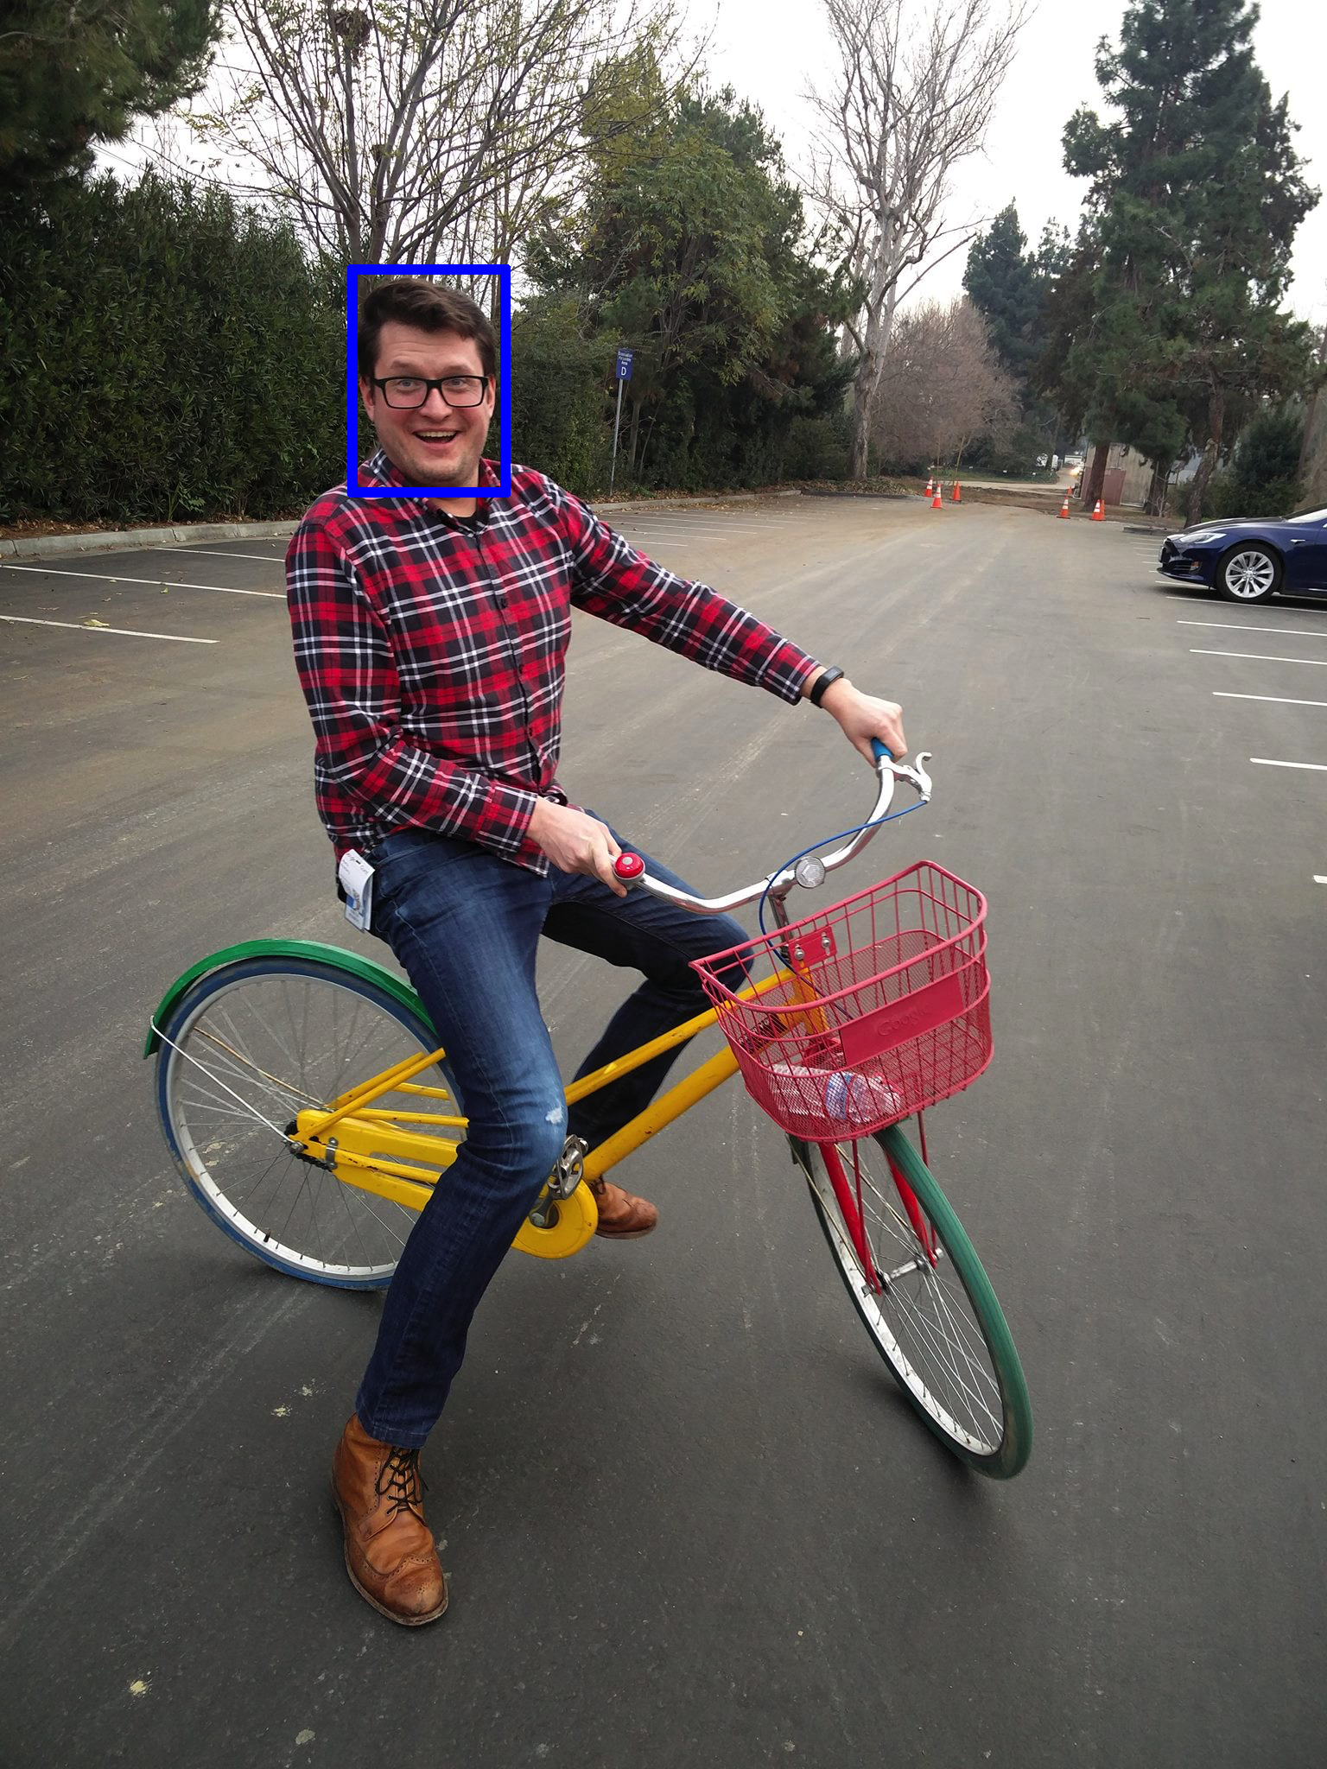
Computer Vision– Edge
Basic Detection
Programmatic
Fast
Notes:
When I talk about local, or edge computing what I am referring to is computation that is happening on a local device. If I have a webcam plugged into my computer and process that image on my computer – that’s edge analytics.
When we do computer vision analysis on the edge there are going to be some strengths and some weaknesses. First of all the computations are going to happen really quickly – especially if we are running a powerful CPU.
The kinds of computations that we are going to be doing will be more programmatic. What I mean by this is that we are going to be using certain features of the image to analyze it – for instance when looking for a face we are going to be looking for specific shapes and color gradients that we think a face will have.
Due to this programmatic nature the kinds of detections we are going to be making is also going to be somewhat limited – we can find faces, eyes, lines, edges, broad objects like that.
This is still incredibly useful in all kinds of applications, and I will talk about some of those a bit later on.

Slide 4
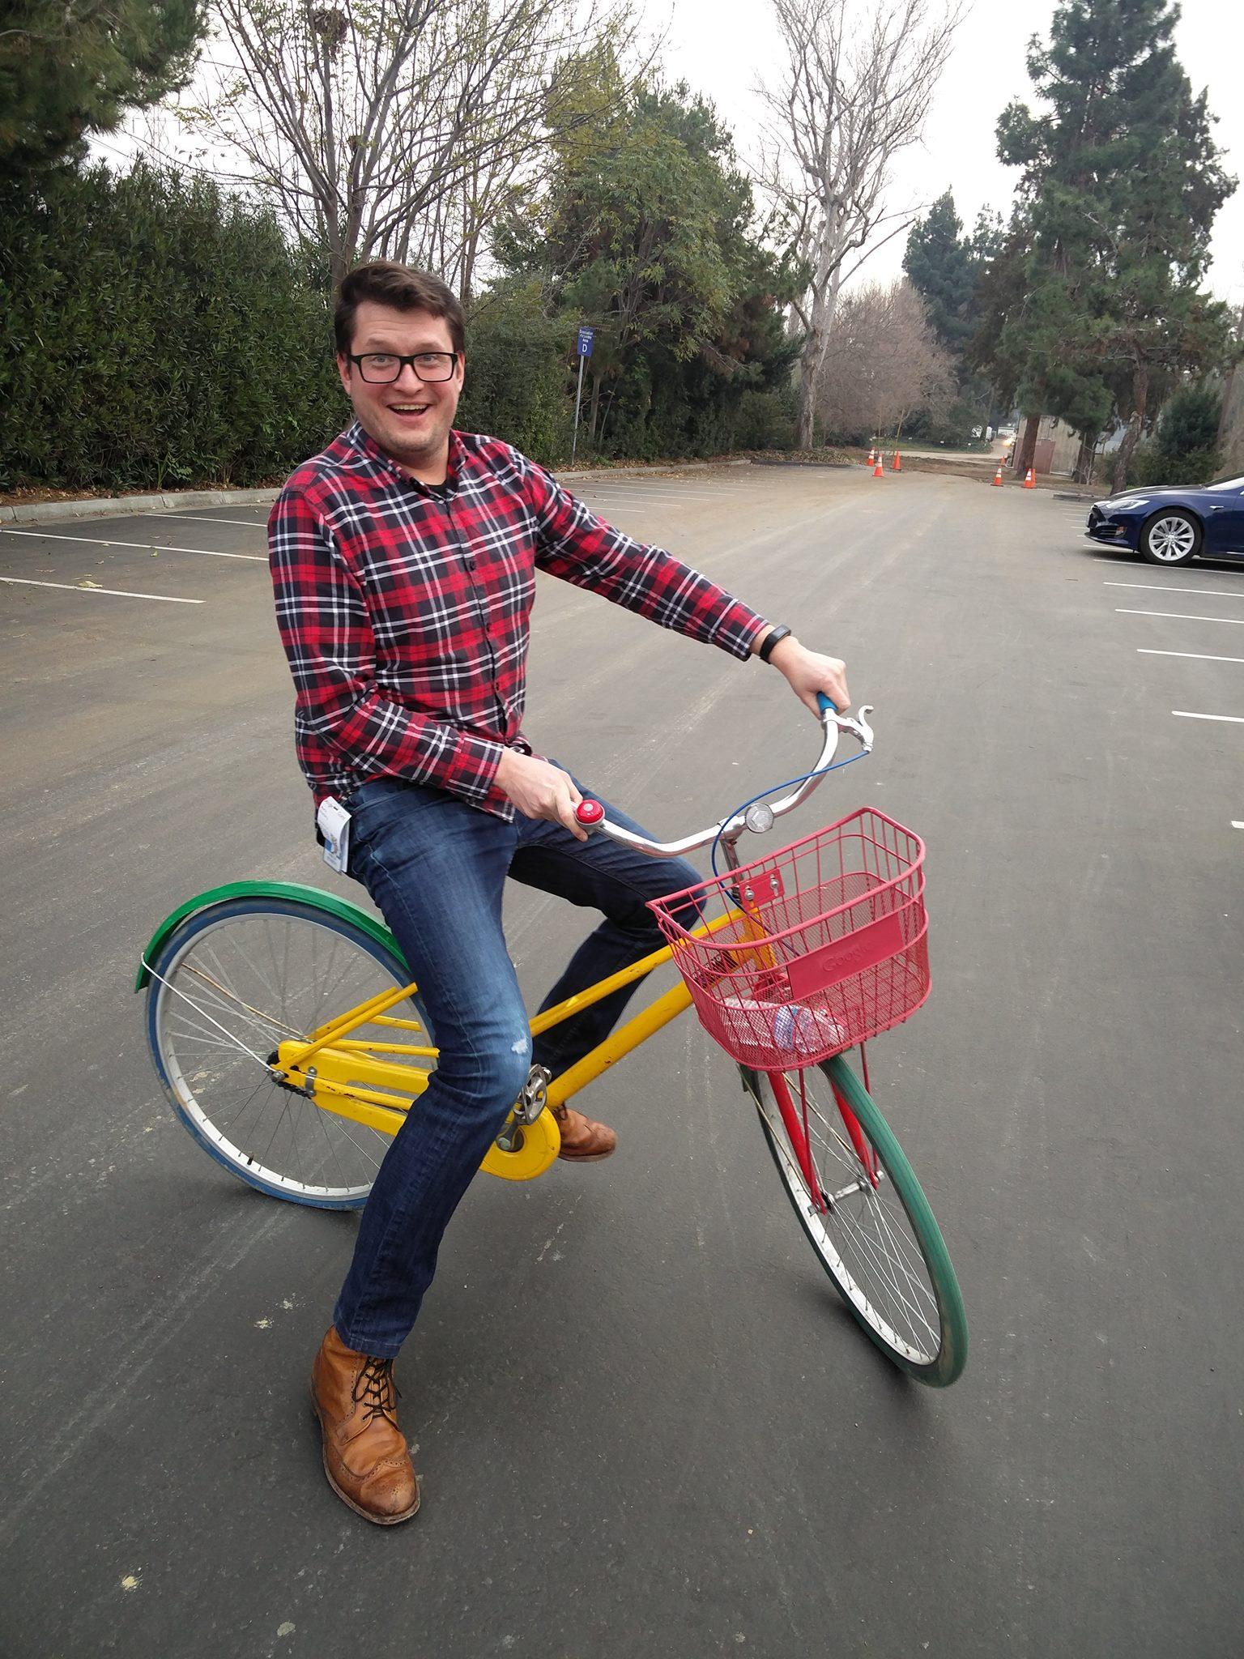
Computer Vision– Cloud
Person: 90%
Parking Lot: 87%
Metadata
Machine Learning
Heavy Resource Requirements
Slower
Less fine control
Bike: 92%
Notes:
Now if we are looking at computer vision in the cloud things look different. We are no longer just looking for specific objects, but we are going to be analyzing an image and getting back what the algorithm thinks is in the image and with what level of certainty.
How does the cloud do this? In short: Machine Learning. What do I mean by machine learning? This is a very broad topic but in short you show a computer 10,000 images of a bicycle and the computer learns what a bicycle looks like. I will give a very brief overview of how this works a bit later on – but for now what is important is that this process is extremely compute intensive – especially when we are training the computer to look at those bikes.
Because of this heavy compute requirement this kind of image processing is perfect for the cloud – we can leverage the processing power when we need and spin it back down when we are done.
However since we will have to go through the network this process is going to be inherently slower – think of using this to analyze a still image instead of a live video feed.

Slide 5
Put it Together!
Person: 90%
Parking Lot: 87%
Bike: 92%
Notes:
So lets take the two methods and put them together! As you will see in the demo later on, we can take the real time simple computer vision of local processing, and combine it with the slower, but more in depth processing in the cloud!

Slide 6
Intel IoT Overview
Notes:
Before I get into the details of how these systems work and how we can use them together I want to give you guys an overview of both Intel and AWS – the Edge and the Cloud.
First Intel – the hardware at the edge- what is their place in the IoT ecosystem?

Slide 7







Intel® Architecture Powers Endpoints, Gateways, Networks, and Cloud
NETWORK
(DATA CENTER)
THINGS (ENDPOINTS)
GATEWAY
CLOUD-BASED ANALYTICS
The Intel® IoT Platform: A blueprint for connecting devices into the cloud for developers to better leverage data, customize, and scale
7
Notes:
Overview of Intel IoT Architecture:
- Start: Things – Sensors, Actuators – webcams, temperature, light, servos, etc.
- Finish: Cloud Based Analytics – Deep Learning, Predictive Maintenance, Big Data - AWS
- Well technically the finish is deciding what actions to take from the analytics, but Intel can’t help you there.
- How do we get from start to end? Intel Gateways and AWS servers.
- Things need a way to talk to the data center. They often don’t have a built in internet connection. They use serial protocols like modbus, I2C, short range radios like bluetooth, zigbee, zwave. By connecting over those protocols to a gateway the things have a way of communicating to the data center.
By acting like a central data hub the gateway can also accomplish a few other important functions. Even if the things could communicate to the internet on their own, that’s not a schema that you would want to use. Dealing with that number of individual connections is going to be pretty inefficient and really insecure. More connections is going to means larger surface area for any kind of malicious attacks. So minimizing the number of connections is going to go a long way to help your iot deployment be more secure.
This gateway will also be handling all of the edge compute that we need to do when we want to run local computer vision analysis.

Slide 8
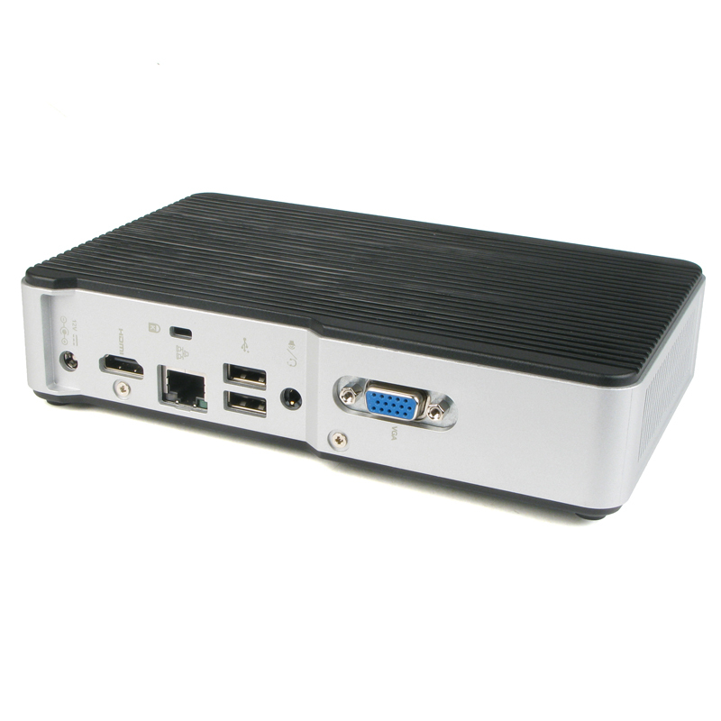
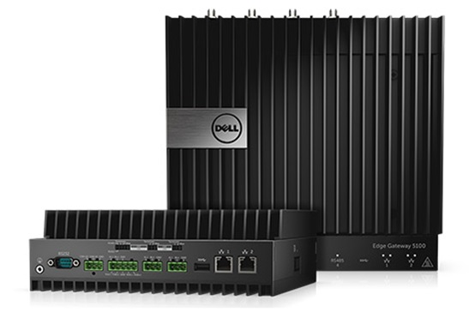
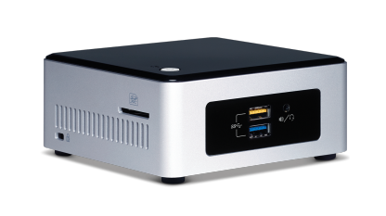
Intel® NUC Gateway
Scalable
Open Source
Wide Range of Specifications
Notes:
Specifically when I talk about Intel Gateways I am referring to the NUC Gateway. A NUC is a ”Next Unit of Computing” a term coined by intel to which refer to a series of small, customizable PCs which come in a wide range of specifications. The specifications range from lightweight prototype devices meant for a simple smart home system, all the way up to a hardened commercial grade device with industrial I/O running on the latest generation i7.

Slide 9

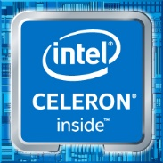
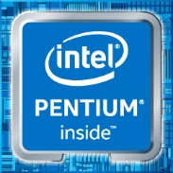
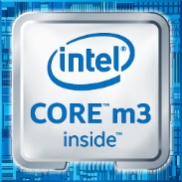
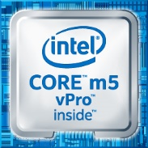

Scalable Processing
From Intel® Atom® to Intel® Core™ i7
Get just the right amount of compute power at the edge
Notes:
Just the right amount of compute power – find a balance between power requirements, heat, cost.
Since all of the processors use the same x86-64 architecture you can shift from one platform to another without having to worry about architecture compatibility.

Slide 10




Open Source Technology
MRAA
Notes:
Intel IoT is based on open source technology. All of our libraries, code samples, and operating systems are open source.
For instance on this gateway we are running Ubuntu 16.04 and leveraging OpenCV to do our edge computer vision. Ubuntu is a very
Familiar OS to anyone that has developed on linux and OpenCV is an open source computer vision framework that I will talk a bit more about later on.
In short having open source technology means that you get better interoperability by working across other open source platforms.
Also as you are developing your project you can pull whatever pieces of code you need from our repositories, use what you need, and not worry about licensing later on.

Slide 11
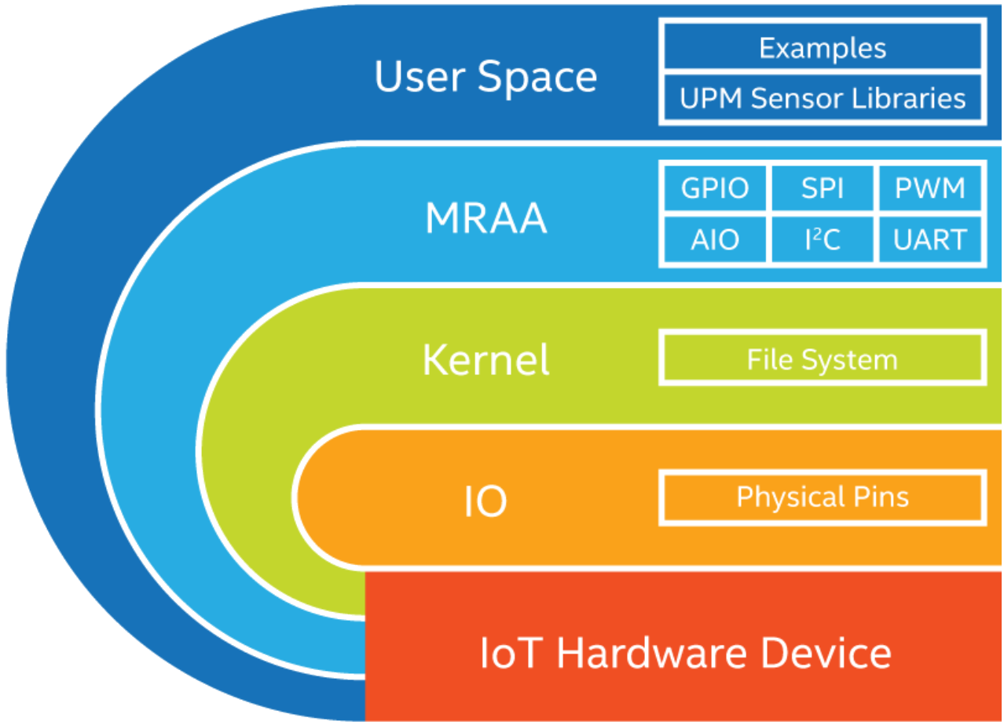
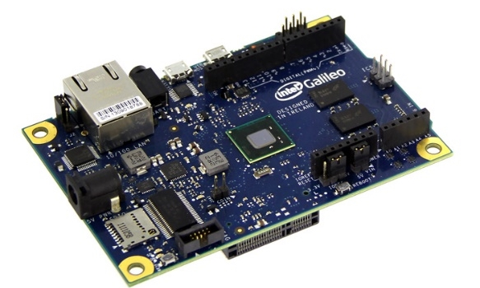
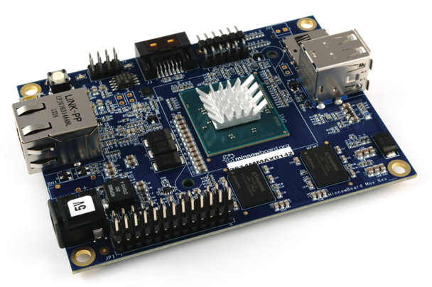
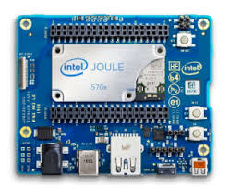
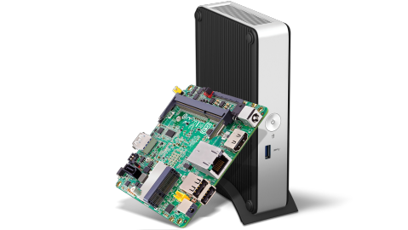
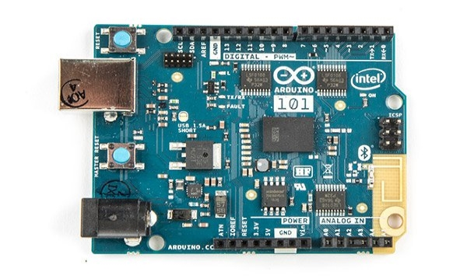
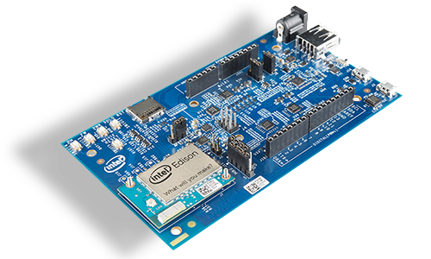
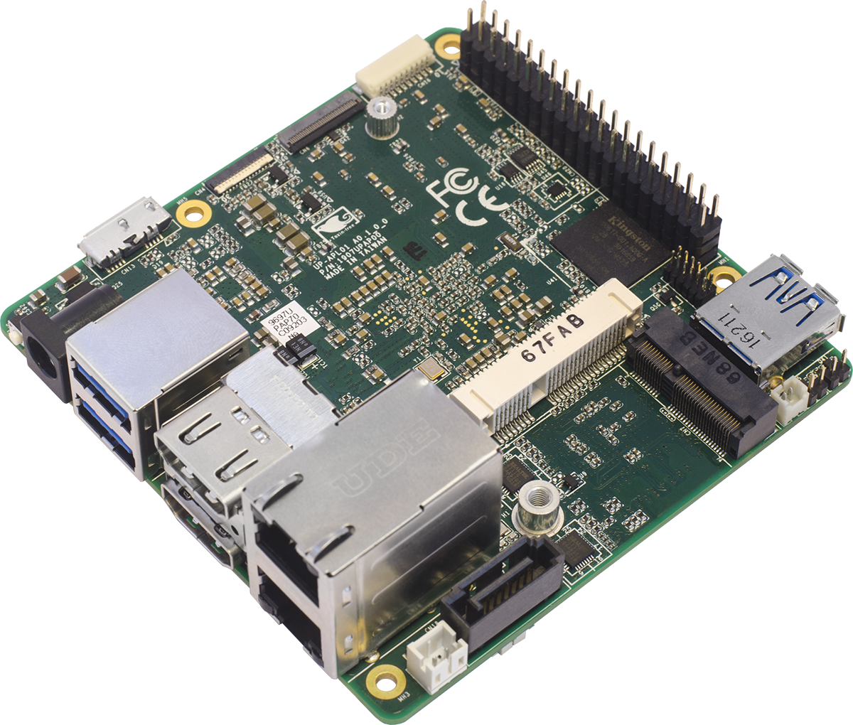
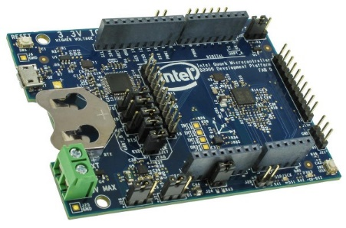
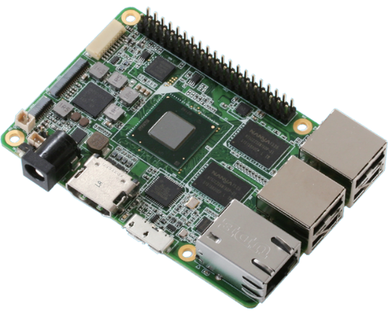

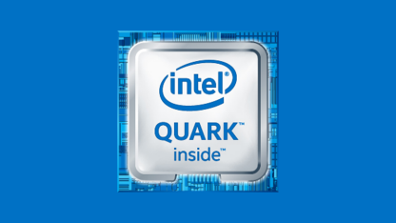
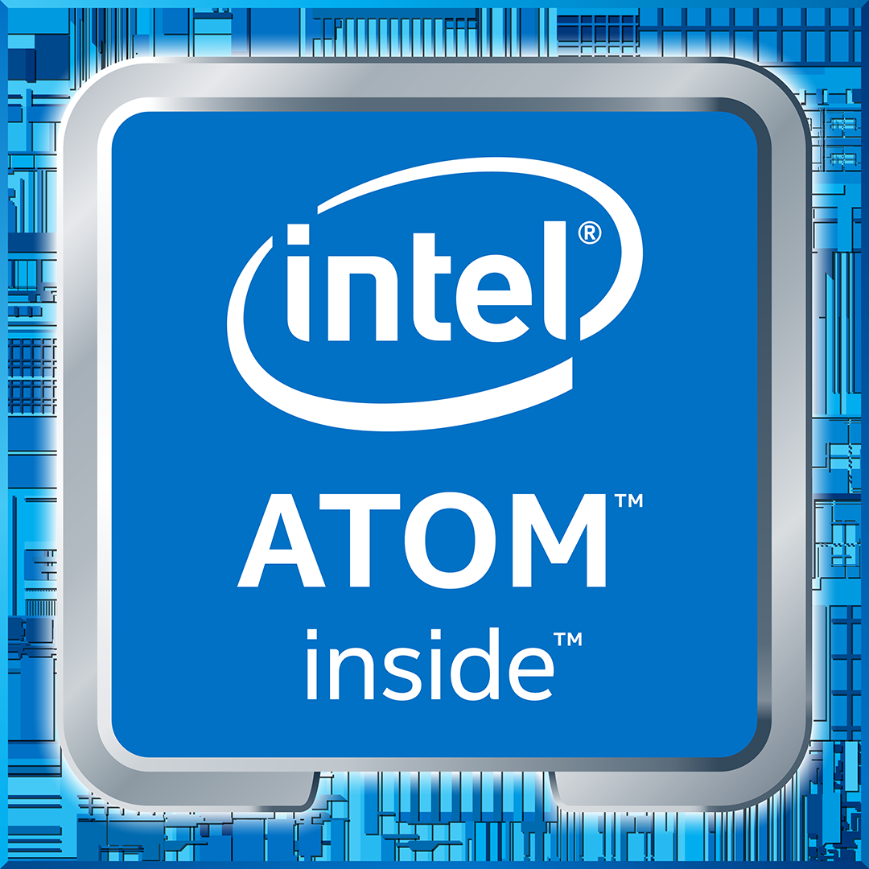
MRAA – I/O Library
Typical stack on UNIX systems:
Supports Intel, non-Intel (community added) MCU boards, UNIX boards and IoT Gateways
Simple I/O protocol control for:
Open source on GitHub:
http://mraa.io
GPIO
Analog (AIO)
PWM
SPI
I²C
UART
1-Wire
Firmata
Notes:
So I mentioned MRAA in the last slide, but I didn't really talk about what it is. MRAA is a C++ library, with bindings for both Javascipt and Python,
Is used to control low level sensor functionality. This means that you can access GPIOs, read/write to an I2C bus, or interface with a microcontroller board over Firmata amongst other low level interactions.
I also mentioned interoperability earlier. Well you can use MRAA across a huge range of platforms – Intel NUCs, the UP board, Minnowboard, or any other intel microcontroller, MRAA will even work with non intel boards like the rasperry pi, beagalebone, even a DE10-Nano which is an FPGA which runs an Altera cyclone SOC.
So for instance if you are developing a project on one board you can move across to something that fits better – even to a different architecture – and take your low level sensor control code with you.

Slide 12
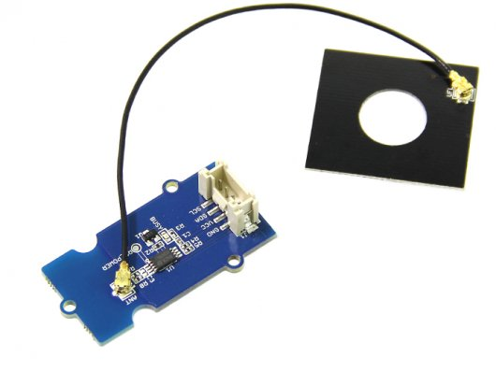
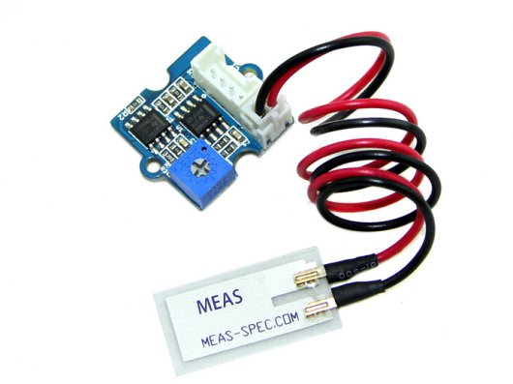
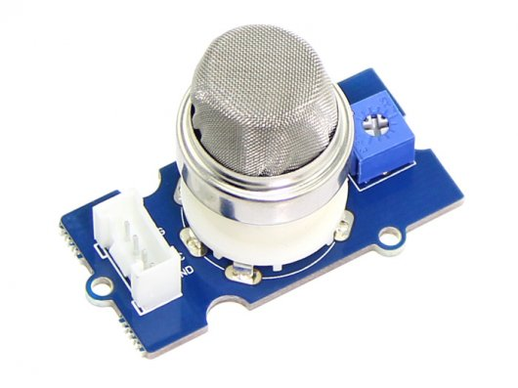
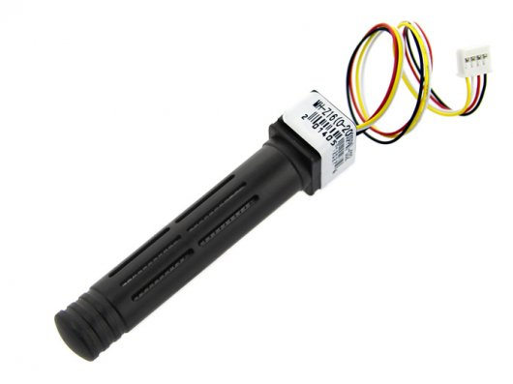
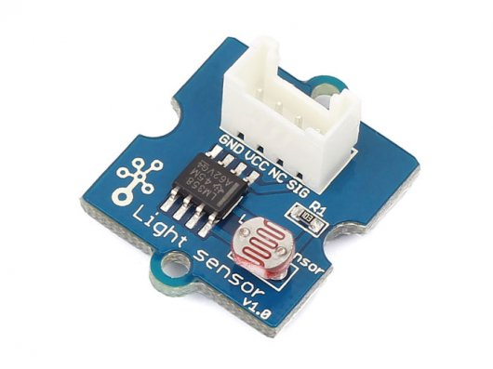
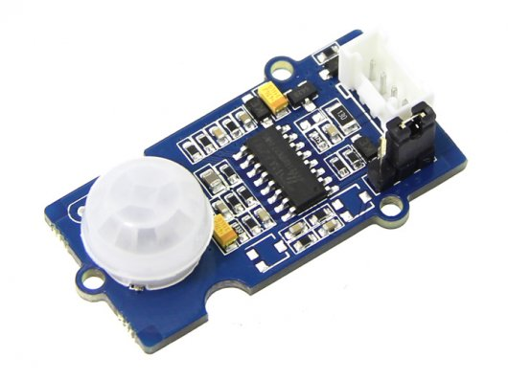
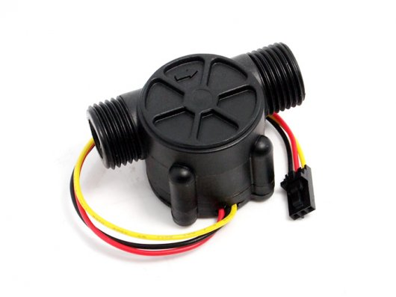
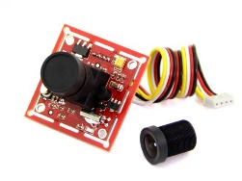
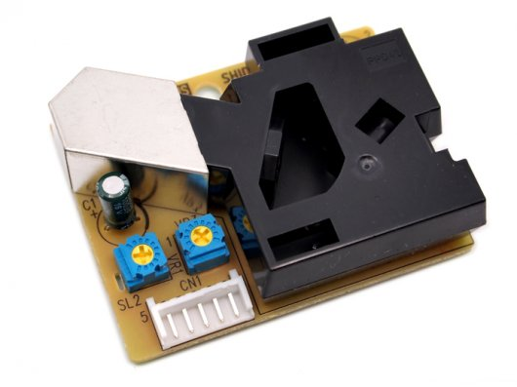
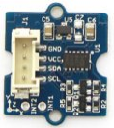
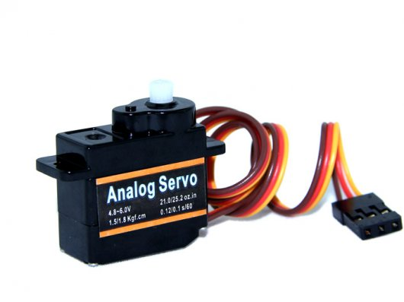
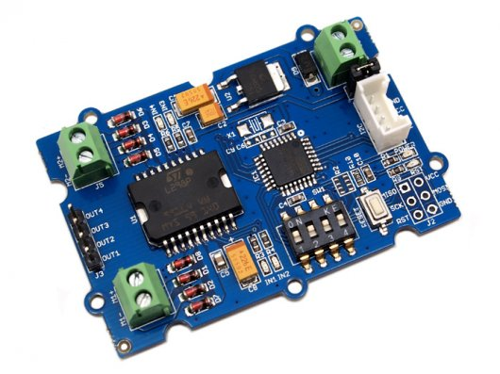
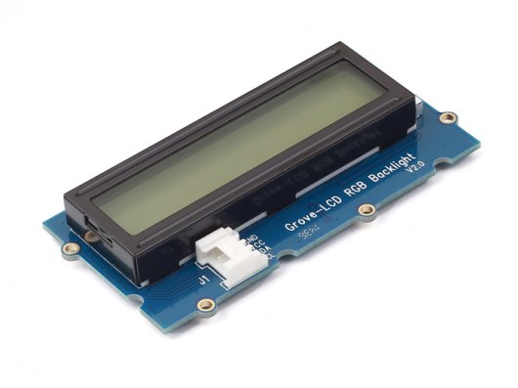
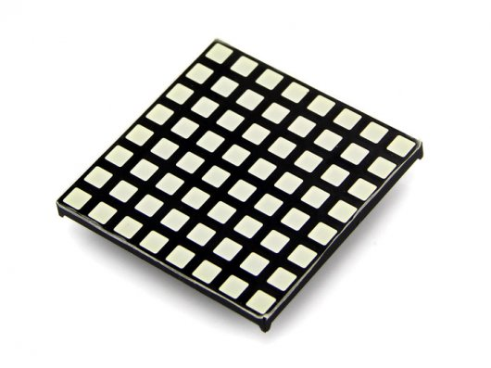
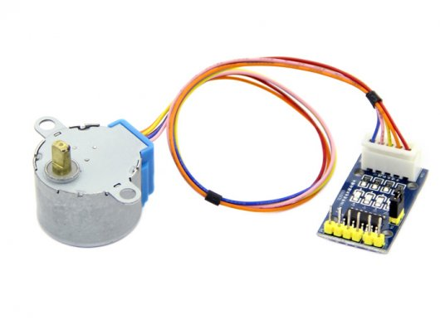
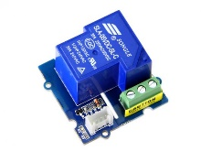
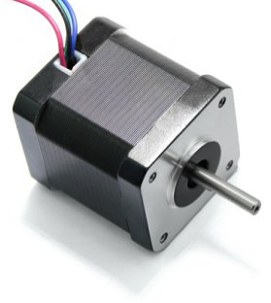
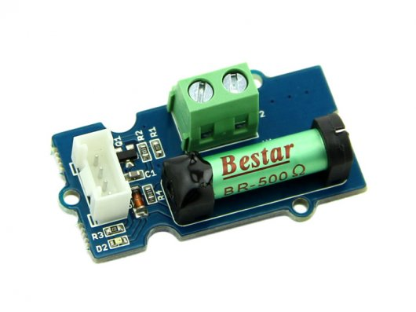
UPM – Sensor Library
Software suite for sensors, actuators, radios and protocols
Open source, Intel maintained, community supported:
http://upm.mraa.io
Sensors
Actuators
Notes:
Now, having these low level libraries is great, but as a developer its nice to have access to high level APIs as well. That’s where UPM – ore the Useful Packages and Modules - library comes in. UPM is built on top of the low level MRAA library and has high level api sensor support for over 300 sensors and acutators. These sensors are things like temperature, moisture, acceleration, magnetic field while actuators cover thigns like stepper motors, lcd displays, or just simple relays.
The sensors range from simple and inexpensive prototype sensors to more hardened industrail grad sensors. So with UPM you can develop a proof of concept quickly and then when you are ready to move to production you can swap out your prototype sensor with a commercial sensor and keep your same control code.

Slide 13
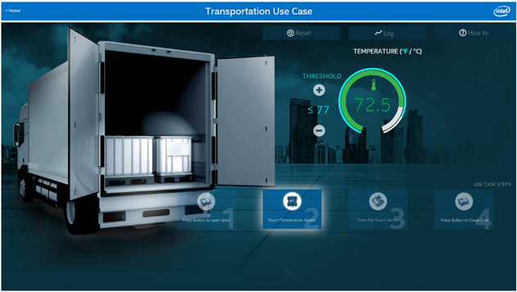
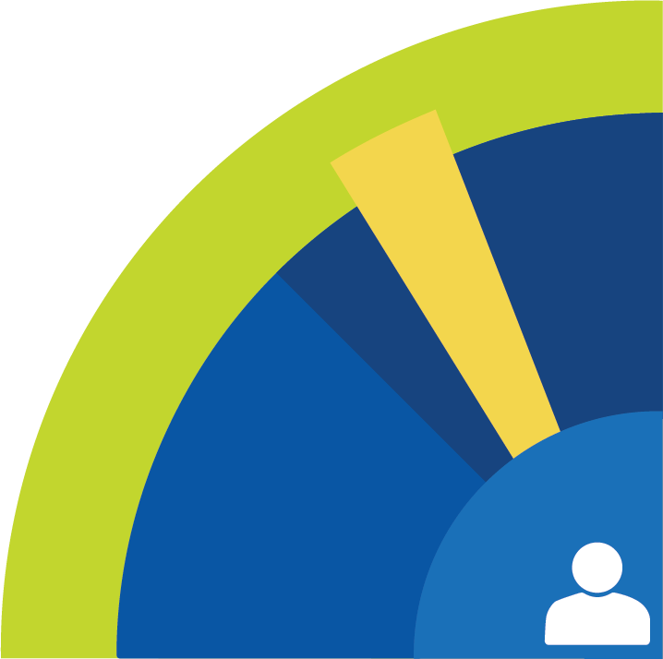
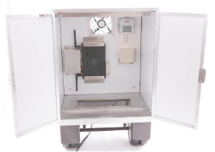
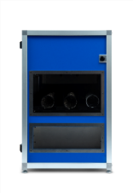


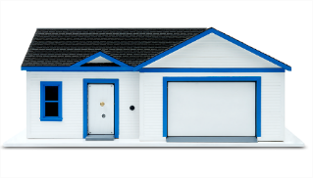
Code Samples
Code
Write your own or reuse sample code & packages for your own projects.
Code snippets
Mini projects
End to end solutions
End-to-end Reference Implementations
Transportation
Smart Home
Retail
Code
Notes:
If you want to start developing on the Intel platform you can find a ton of resources to get your project off the ground. There are code samples, proof of concept projects, full IoT solutions with descriptions and code. You can even find market research for certain IoT verticals like smart home, smart transportation, retail and more.
All of the code is open source so you can use whatever portions you want and not have to worry about licensing issues.

Slide 14
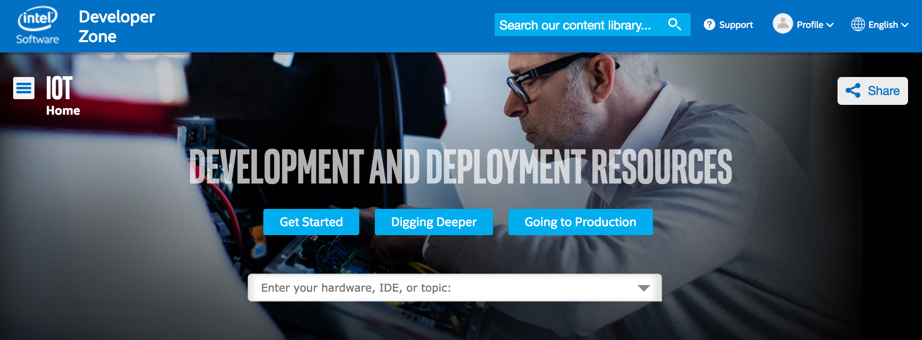
Intel Developer Program: Software.intel.com/iot
Notes:
So finally how do we tie all this together? Intel has created a hub for IoT developers at software.intel.com/iot. Here you can find all the software, hardware, IDEs, community forums, everything I talked about so far and much more. If you want to learn more about developing IoT with Intel this is a great place to start.

Slide 15
AWS Overview
Notes:
Ok so that was an overview of intel IoT, lets do a quick overview of AWS - the cloud provider we will be looking at today.

Slide 16

AWS* - On Demand Cloud Computing
Virtual Machines
Compute
Database
Analytics
AI
IoT
Notes:
So what is AWS? Some of you may be pretty familiar with it, but just so we are all on the same page lets go over the basics.
So AWS – or Amazon Web Services – has become ubiquitous in modern cloud computing.
Its a collection of cloud services run by amazon. These services cover a huge range of developer needs – virtual machines, serverless compute, databases, analytics, artificial intelligence, Internet of things, and a lot more.
The core idea behind AWS is that it is an ”on demand” platform. This means that you only use their services when you need to and the services will scale automatically to meet growing or shrinking usage requirements.
Overall AWS provides a great toolbox for leverage the power of the cloud for any of your projects or applications.
I want to go into a bit more detail on a few of the services that you would most likely start using if you are new to AWS.

Slide 17
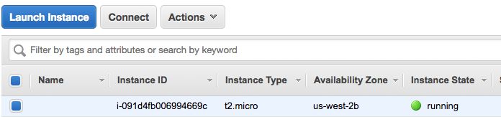
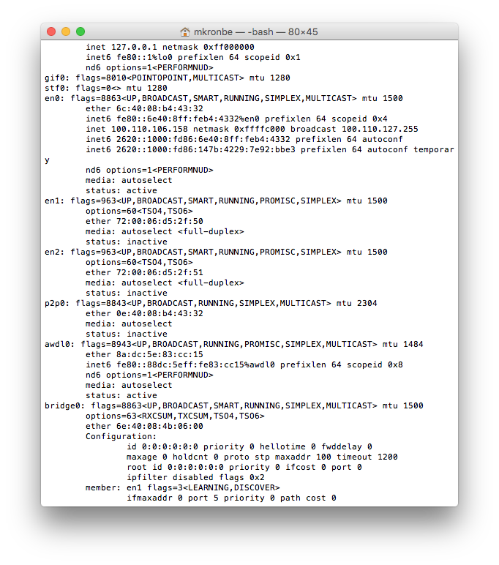
AWS EC2
Quickly deploy preconfigured or custom VM
Scale with load
Notes:
First up is EC2 – the Elastic Compute Cloud. This is probably one of AWS’s most popular services. It allows you to quickly create a virtual machine to the Amazon servers. You can use a number of predefined VMs – covering almost all operating systems – Red Hat, Ubuntu, Windows, Amazon Linux. You can also create a custom VM with the hardware specs and operating system that you need.
Its called elastic because the VM can scale up and down dynamically. So lets say you are running a VM server and all of a sudden you have an uptick in usage – EC2 can allocate more processors and RAM to keep up. It also means that you are not going to be paying for unused compute when demand goes down.

Slide 18
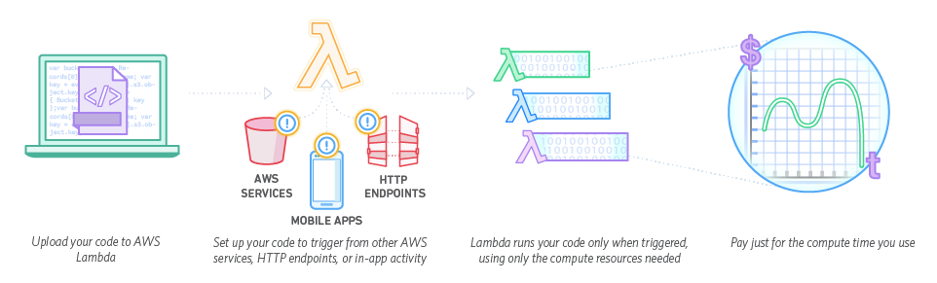
AWS* Lambda
Serverless compute in the cloud
Notes:
Next is AWS Lambda. This is a serverless function runtime environment. What I mean by this is that you can write a piece of code – in python, javascript, java, or C# - deploy it to Lambda and assign a trigger for that code. When the code is triggered – for instance from an HTTP request – lambda will run that code and then shut down.
Basically if you want to run a piece of code somewhere in the cloud without having to worry about provisioning a VM, or have to worry about paying for compute time that you are not using, lambda is a great option.

Slide 19
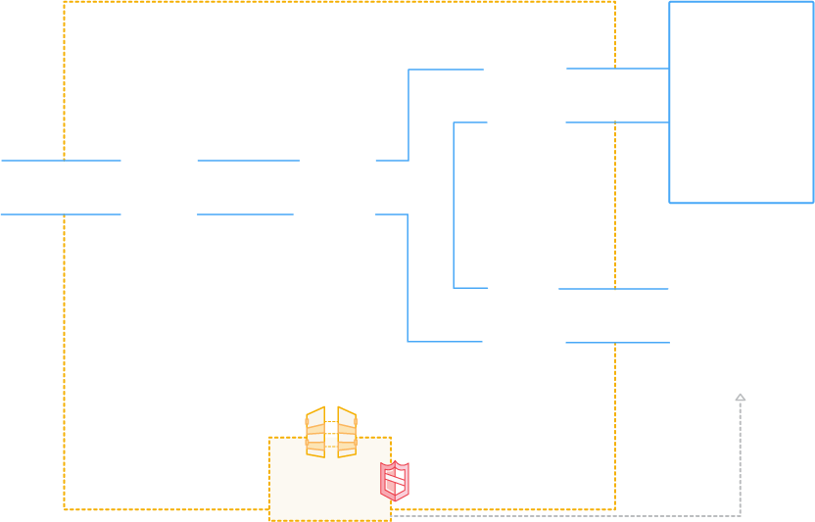








AWS IoT
AUTHENTICATION
Secure with mutual authentication and encryption
AWS Services
- - - - -
3P Services
RULES ENGINE
Transform messages based on rules and route to AWS Services
DEVICE SDK
Set of client libraries to connect, authenticate and exchange messages
DEVICE GATEWAY
Communicate with devices via MQTT and HTTP
APPLICATIONS
SHADOW
Persistent thing state during intermittent connections
REGISTRY
Identity and Management of your things
AWS IoT API
Notes:
AWS IoT is a collection of services that allow the developer to do a number of useful things. First it allows them to connect a device – a NUC gateway for instance – up to AWS and authenticate that connection through SSL certificates my using an MQTT broker. You can also set up a rules engine that takes incoming data from your device and then connects it to any of the other AWS services – so you can store your sensor data in an elastic search database and then access it from another application. Finally there is a services called “thing shadows”. This is a persistent record of the device state which allows any application to read the state of your device, even if the physical connection is lost.
One way to trigger a lambda fucntion is through incoming data into AWS IoT. So for instance if you want to do some data compute in the cloud, connect up your gateway to AWS IoT and set up a rules engine to trigger a lambda function and have that function do your number crunching.

Slide 20
Computer Vision at the edge – Open CV
Notes:
So now that we have discussed the basics of Intel and AWS I hope you have a better idea of where these two companies stand in the IoT ecosystem.
Lets now come back to our original question of edge and cloud analytics for computer vision. Lets take a look at the edge first where we will be using OpenCV.

Slide 21
Overview
Open Source Computer Vision C++ Framework
Created by Intel in 1999
Large and Active Developer Community
https://www.learnopencv.com/install-opencv3-on-ubuntu/
http://docs.opencv.org/master/d7/d9f/tutorial_linux_install.html
Notes:
So first a brief overview of what OpenCV is. In short it is the most widely used computer vision framework currently. It is written in C++ but is often used with python binding – as we have done in this demo.
It was originally created at Intel in 1999 but has since been taken over by the OpenCV Foundation.
It has a huge developer community – which is great if you are just getting started with computer vision. You can find tons of example code for almost any basic idea. There are forums and tutorials and really all of the tools out there to get you started quickly.
Installation can be a little tricky as it is required that you build OpenCV from source, but there are many great tutorials out there to help guide you, I would recommend starting with the ones listed here:
https://www.learnopencv.com/install-opencv3-on-ubuntu/
http://docs.opencv.org/master/d7/d9f/tutorial_linux_install.html

Slide 22
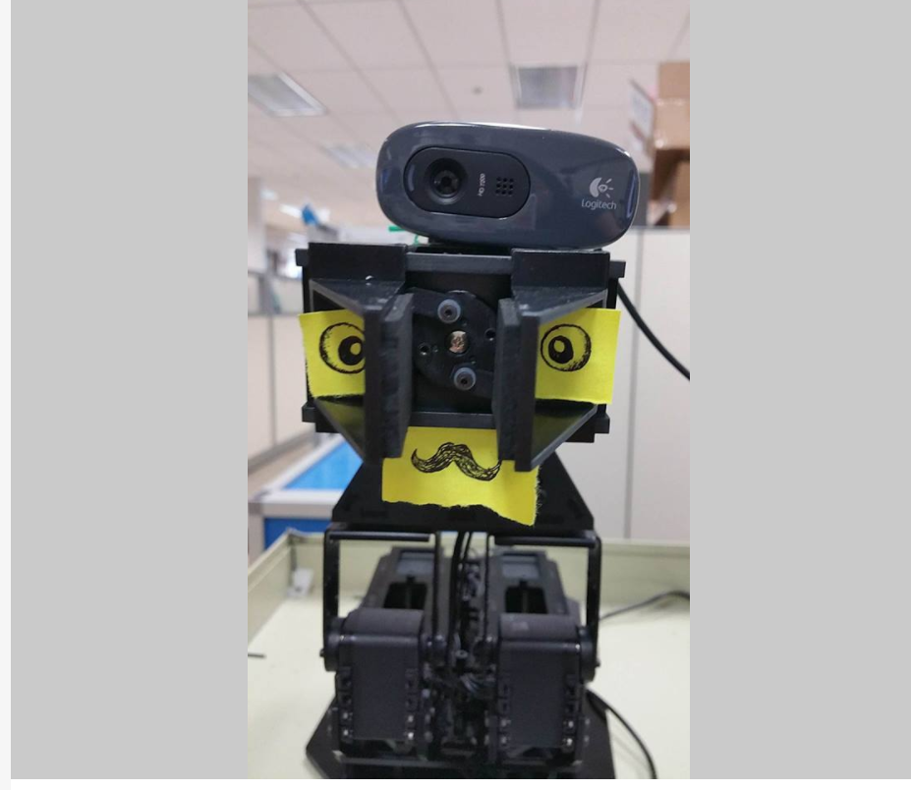
Open CV Uses
Image Transformation
Edge Detection
Facial Recognition
Gesture Recognition
Mobile Robotics
Motion Tracking
Notes:
So what can you use OpenCV for? All kinds of cool stuff! At the heart of open CV is simple image transformations – stretching, scaling, adjusting colors.
These functions prepare images for finding features – for instance detecting edges or corners of an object.
Once you find these features you can start to putt out information from your image. For instance a popular application is locating faces by using the features in a programmatic way. Once again I mean that you would describe what a face looks like based off of circles in a certain orientation, a certain gradient, things like that.
Beyond those simple use cases there are countless libraries out there for all kinds of applications – depth sensing, motion tracking, robotics, gesture recognition.
On this slide you can see a photo of our friendly office robot – Mrs. ASP – who uses openCV to track faces and detect when people smile at it - which is a lot, I mean just look at that face :3
The demo we will be looking at today is actually part of this robot – just without the robot part.

Slide 23


Sample Code – Find Corner
Notes:
So how does using OpenCV look in practice? Well here is a script written in python that detects corners of an image. It does this by using a method called “Harris Corner Detection” which looks at pixel value derivatives in X and Y to determine where a corner exists. But you don’t have to understand all of the math involved to be able to use the algorithm. You do have to understand what the fitting parameters are however to be able to optimize your function. OpenCV has a Corner Harris library which you can import, set those fitting parameters- block size, aperture, etc – and then run the algorithm.
As you can see in not too many lines of code we are able to find where the corners of an image are.

Slide 24

Hardware Requirements
Open CV can be CPU intensive
Open CV can be RAM instensive
Notes:
One final note is on the hardware requirements to run OpenCV. OpenCV can run on almost any hardware – the question is how quickly. For modern applications I would recommend a multi core 64bit CPU – like one of the shiny new intel i7s. OpenCV is optimized to run on Intel architecture and can take advantage of multiple cores to run many of its transformations in parallel.
The system load will dramatically increase if you are trying to do real time video analysis as well as all of the transformations have to be done frame by frame.

Slide 25
Computer Vision in the Cloud – Rekognition
Notes:
So then how about computer vision in the AWS cloud? Well there is an entire service which is called AWS Rekognitionn meant for just this very thing – and it is really cool!

Slide 26

Overview
AWS image analysis service
Introduced Q4 2016
Uses deep learning algorithm
Notes:
Rekognition is a service that was launched Q4 of 2016 – so it is a fairly newcomer to the AWS service lineup. It can look at an image and pull out all kinds of data who is in the image, what their emotions are, where they are, what kinds of things they are holding – and yes before you ask it IS exactly like the T-800 vision in Terminator 2: Judgment Day

Slide 27

Notes:
I need your clothes, your boots and your motorcycle.

Slide 28
Overview
AWS image analysis service
Introduced Q4 2016
Uses deep learning algorithm
Notes:
So I was talking about “programmatic” computer vision before. That was because I wanted to draw a distinction between how OpenCV operates and how Rekognition operates. Rekognition operates using deep learning - a type of neural network.

Slide 29

Deep Learning / Neural Networks
Notes:
The topic of neural networks is massive and I don’t want to get to far down a rabit hole, but here is basically how it operates:
You give the algorithm an array of “input nodes”
these nodes are combined at one or more layers of “hidden nodes”
When I say combined I am referring to a specific summation function which takes the value of incoming nodes and multiplies it by a “weight” associated with each node to node connection.
If that sum is above a certain threshold value – bias – the node passes its value on to the next, and so on until you get to a set of output nodes.
Now the magic happens when you give the algorithm a set of input AND a set of corresponding output nodes. When the algorithm has both the input and the expected output it can train all of those connections and biases.
Basically it adjusts all of the network weights until it can produce the output that you tell it to. Once it can do that, you give it an input without an expected value and hopefully it is able to do use its now trained network to determine what the output should be.
This system resembles how neurons pass electrical impulses along our brain network which is why it is referred to as a neural net.
So how does that actually tell you that the girl in the previous picture is happy? Well lets take a look at a really simple computer vision example.

Slide 30

ABCs
7x9 pixel images of A B or C
63 input nodes – 1 for black pixel 0 for white pixel
3 output nodes – A, B, or C
Notes:
Lets say you want a neural network to recognize the letters A, B, and C.
For your input nodes you would have an array of pixel values – 1 for black and 0 for white. You would have 63 input nodes since the images we are looking at are 7x9 pixels.
There would be 3 output nodes – one for A, one for B, and one for C.
When you train the network you would input the array for A and set the output to (1,0,0) , for B (0,1,0), and for C (0,0,1)
Once the network is trained you should see the same output when you give it you A, B, or C.

Slide 31

Training?
Math – Basically the chain rule with partial derivatives
Notes:
How do you train a network to recognize a A B or C? Basically math. A bit less basically you apply the chain rule to the partial derivative of the gradient of the error – or the expected result minus the actual result.
The point is that this has to be applied for every single node connection which can quickly become an immense computational load.
But you know what's really good at handling an immense computational load - the cloud.

Slide 32

Trained Data
To be successful a neural network needs a massive amount of trained data
Trained Data = Image + Label
~10,000 images to train a network
“BIKE”
Notes:
But what happens if all of the A, B, and Cs don’t look identical? Or even beyond that what if you are looking at 3 dimensional objects that can exist at different orientations and generally look pretty different from one another?
Well that’s when you need a MASSIVE amount of trained data. By trained data I mean a picture of a bicycle with a corresponding label of “bicycle”
As a rough estimate you need about 10,000 individual images of a bicycle fed into a neural network in order to train it properly.
So if you imagine 300,000 input nodes for a 640*480 image, each combined with each other in a hidden later, multiplied by the 10,000 images required you can really see how this is not a task for the edge.
Luckily AWS has already trained their model on hundreds of thousands of images – so rekognition already knows what a bike looks like, what a human looks like, what most common objects looks like in fact.

Slide 33

Result
Notes:
So the result? A really simple way to leverage an incredibly complex algorithm!
This happy looking guy is 99.2% human and he is riding a 97.6% bike!
Hopefully you can appreciate just how much of the complex work has been done for you already!

Slide 34
Edge + Cloud demo!
Notes:
Well now that we have an idea of how to do cloud compute at the edge and in the cloud, lets put it together into one demo and see how it can work in tandem!

Slide 35



S3 + Rekognition
Store Image
Return Analysis
Take Video
Track Face
Detect Smile
Connect to AWS
Notes:
Our setup is this:
An intel i5 NUC running openCV and has an established AWS connection using the AWS Python SDK.
We attach a simple USB webcam to the NUC.
OpenCV will run real time analysis on the incoming video stream, locate any faces and wait for that face to smile.
When it detects a smile it takes a photo and sends it up to AWS S3 which is a simple database service from AWS and then asks AWS Rekognition to run an analysis on that image.
The results are sent back to the console.

Slide 36

Results!
OpenCV can track faces in real time
Rekogntion can report back with what it thinks is in the image
Notes:
And here is the result! We have opencv running locally in order to do real time video analysis, and when triggered we send an image up to AWS Rekognition.
So we can combine the quick response time from running local computer vision analysis with the more complex and in-depth cloud analytics on individual images.
Hopefully this demo will get you excited to create a demo of your own using this awesome technology!
Thanks!

Slide 37
Questions?

